Slide 1
HTT splicing enhancer on-target and off-target effects
Issues about cross-cells/cross-batches comparison
Nov 08, 2022
RDS Group Meeting
Zhen, Dann, Catherine, Joon, Magnus, Jessica

Slide 2
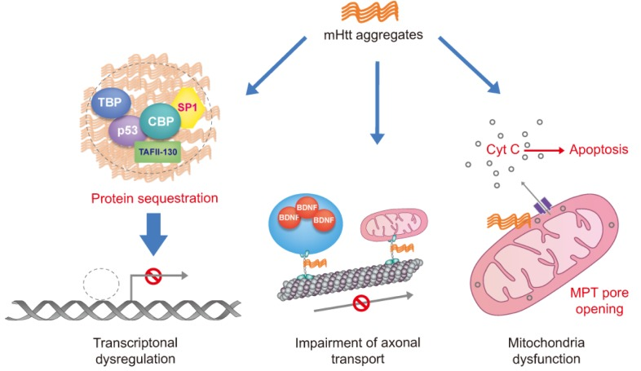
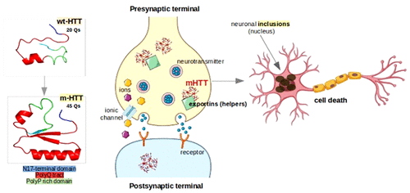
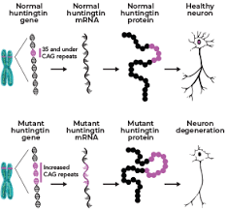
Huntingtin protein (HTT) and Huntington Diseass (HD)
(A)
(B)
(C)
mHTT is believed be responsible for Huntington’s Disease (HD)
wtHTT contains fewer (not more than 35 Qs) polyglutamine residues while mHTT has more than 35 Qs
A general assumption: short polyP domain is that it might act as an antagonist for β-sheet formation and keep HTT soluble
Plots from Sanda Nastasia et al.

Slide 3
Sample similarity from Gene Expression (1st batch)
PCA in 2D for iPSC
PCA in 2D for NGN2

Slide 4
Sample similarity from Gene Expression (2nd batch raw)
PCA in 2D for iPSC
PCA in 2D for NGN2

Slide 5
Sample similarity from Gene Expression (2nd batch raw after removal of low-quality samples)
PCA in 2D for iPSC
PCA in 2D for NGN2

Slide 6
Sample similarity from Gene Expression (2nd batch raw after removal of R4)
PCA in 2D for iPSC
PCA in 2D for NGN2

Slide 7
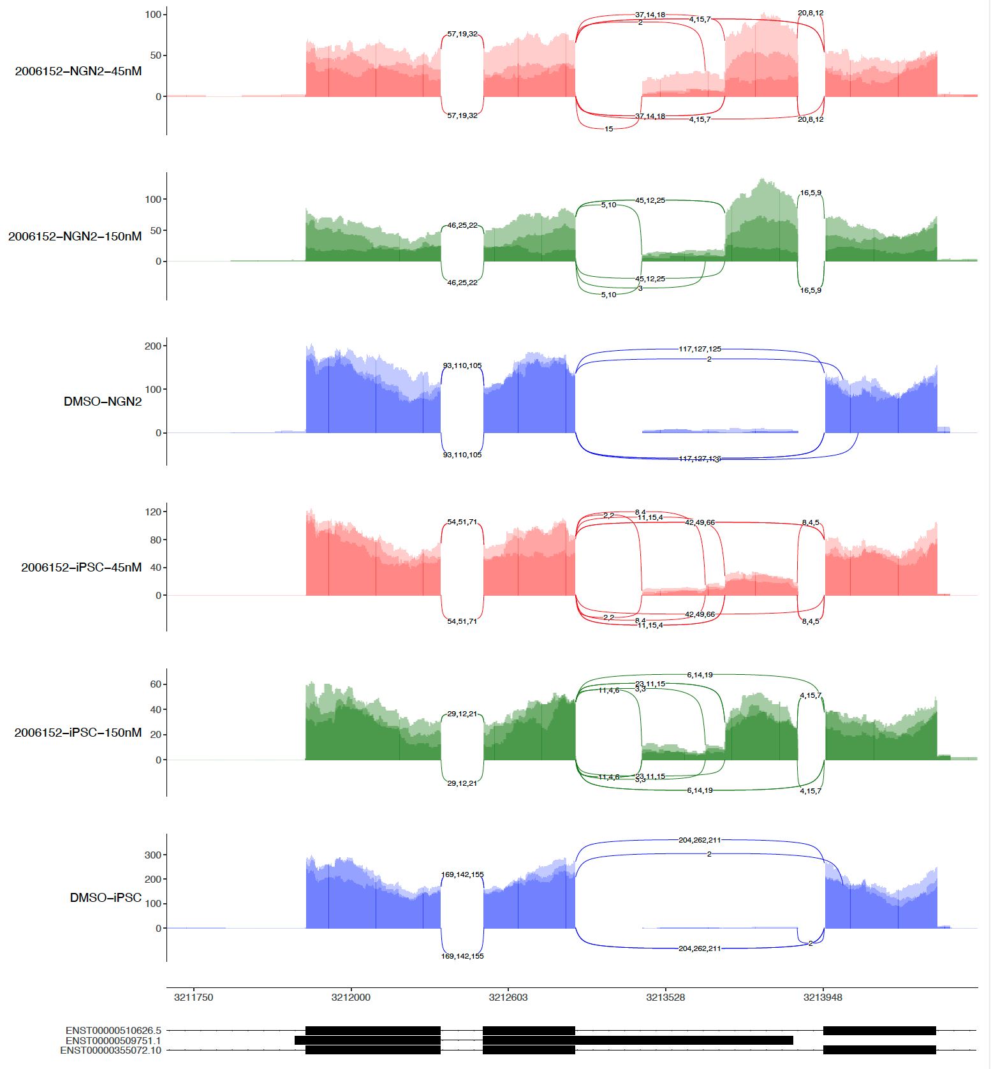
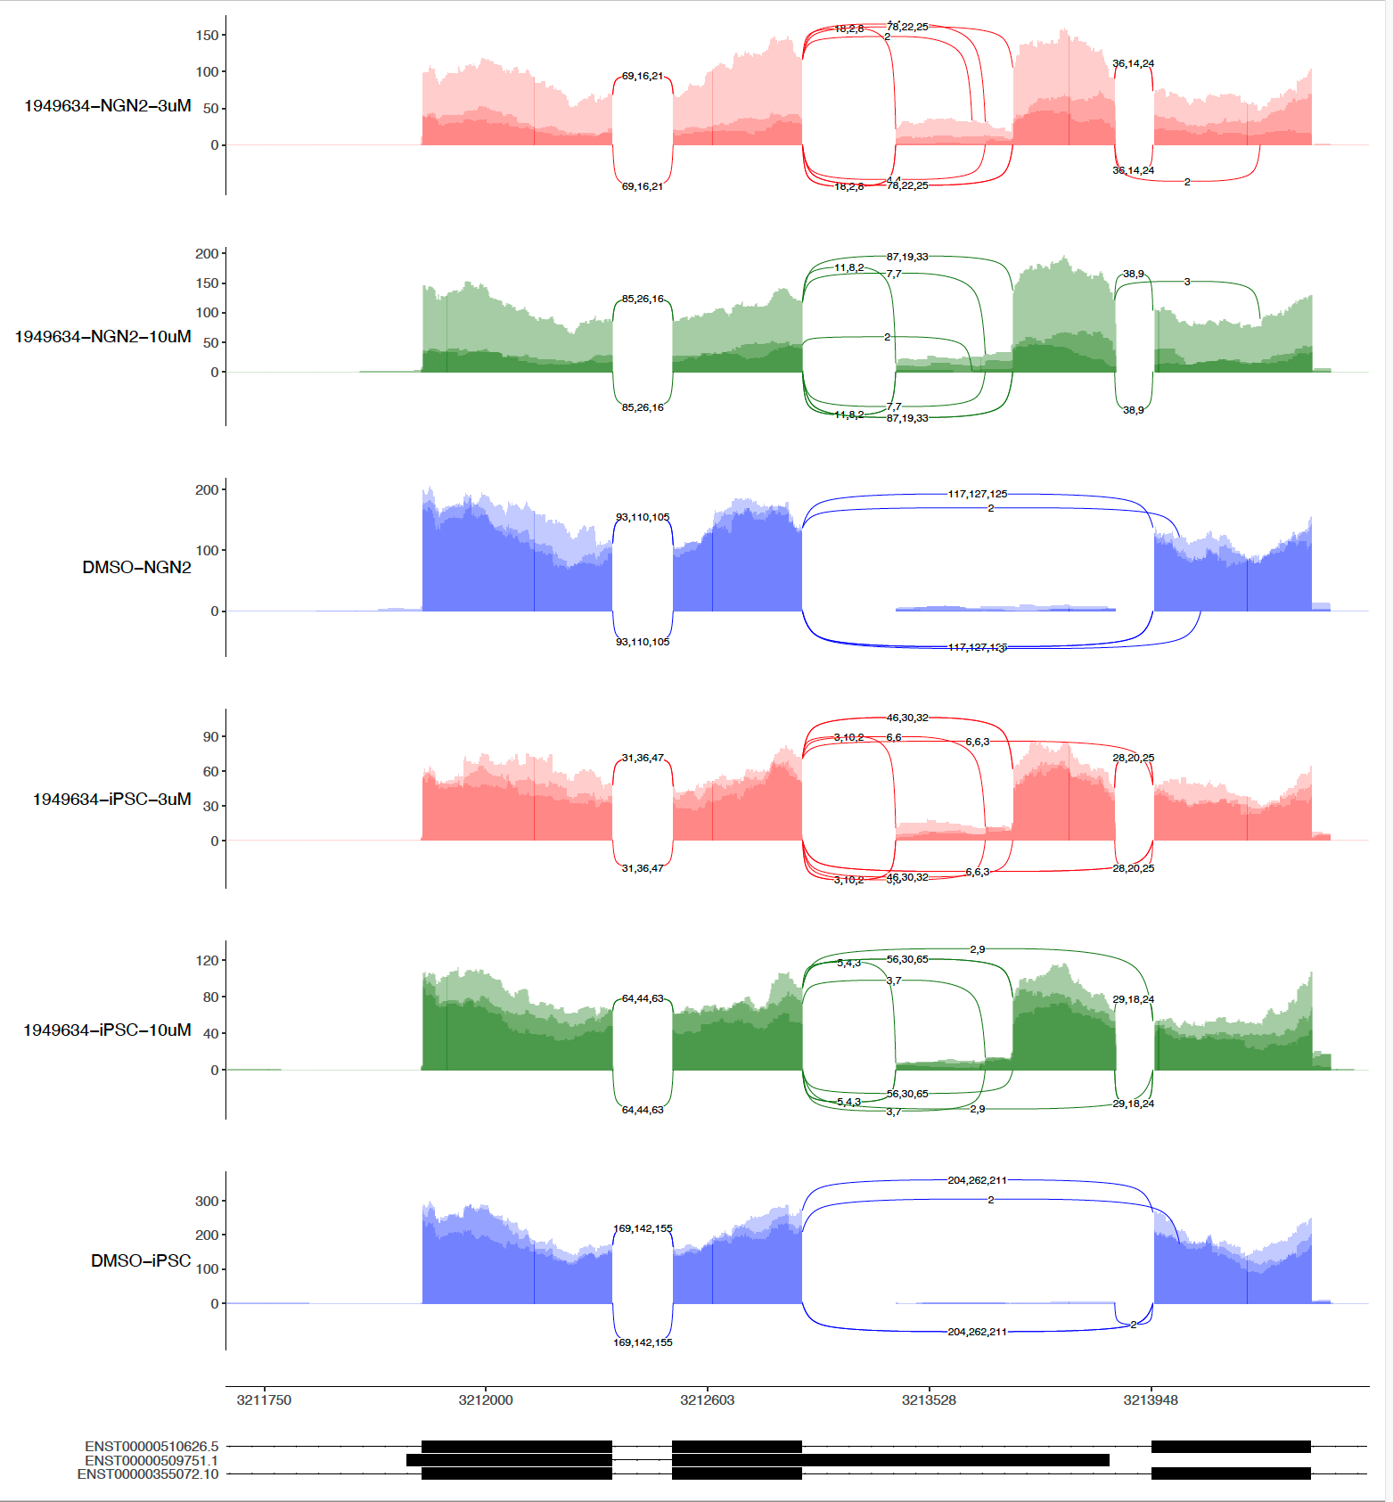
sashimi-plots: 1st 6152 and 9634

Slide 8
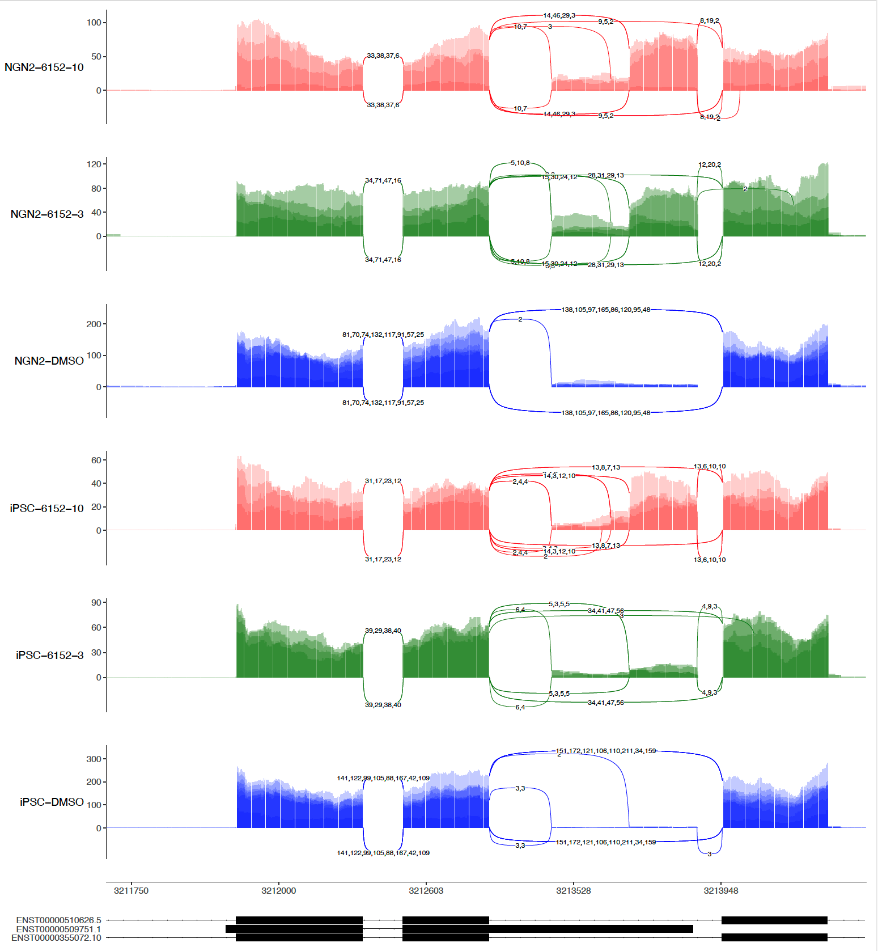
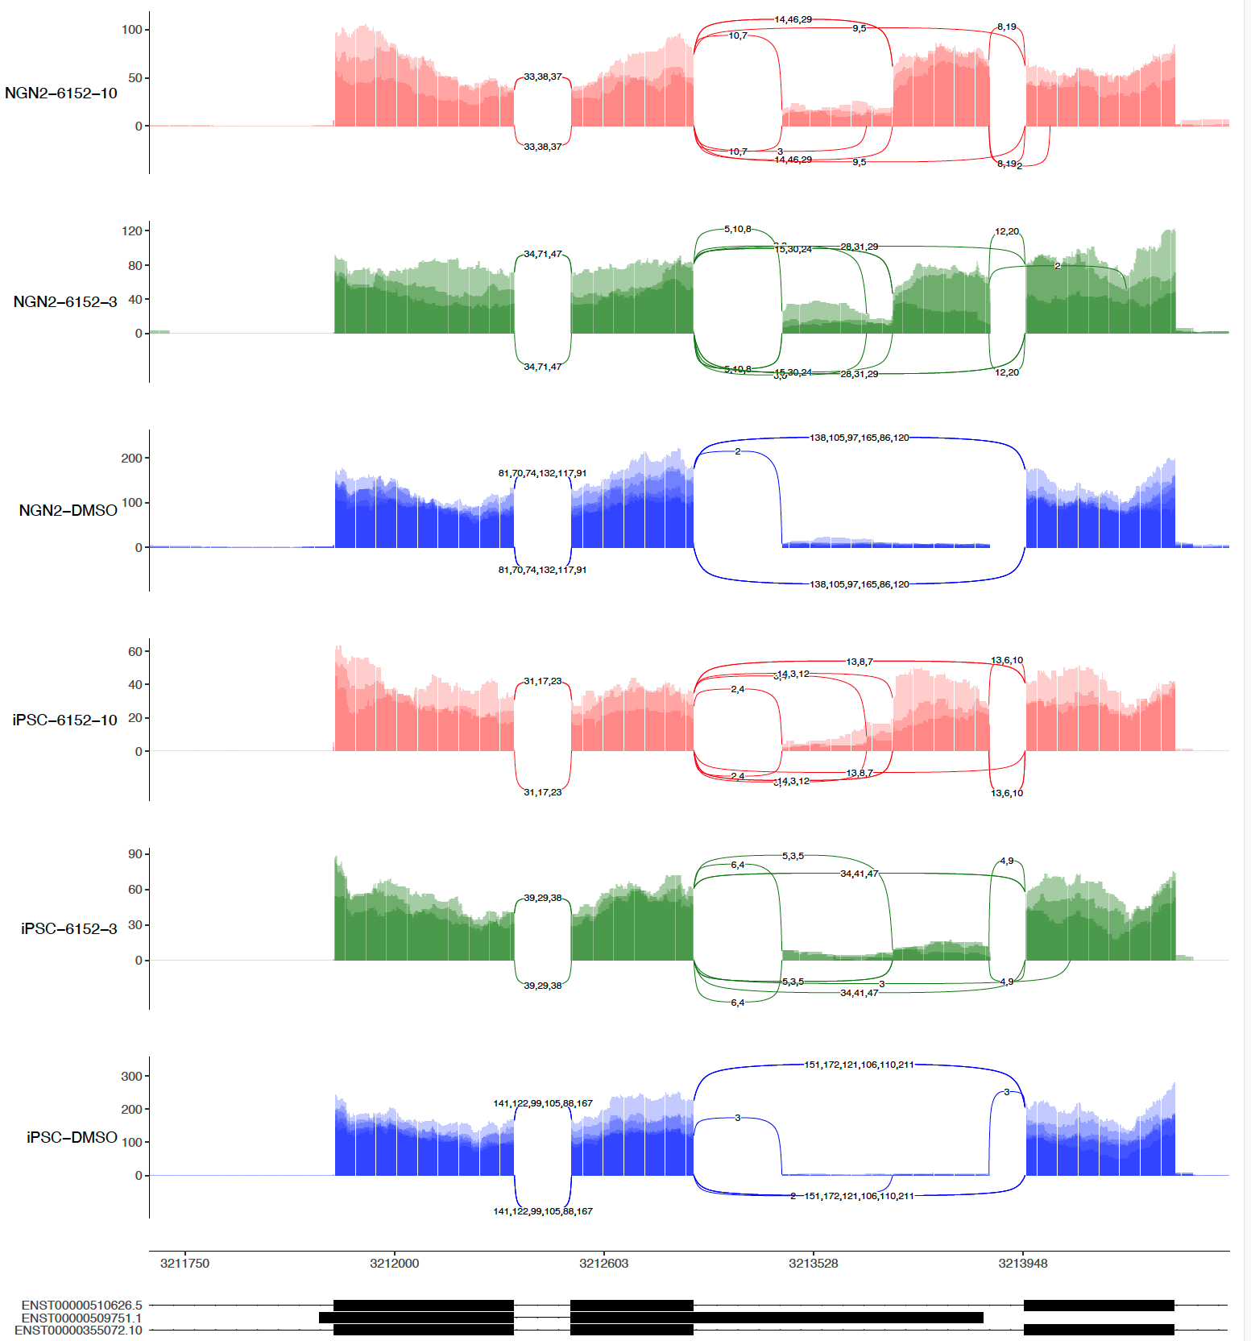
sashimi-plots: 2nd 6152
4 repeats
3 repeats (No R4)

Slide 9
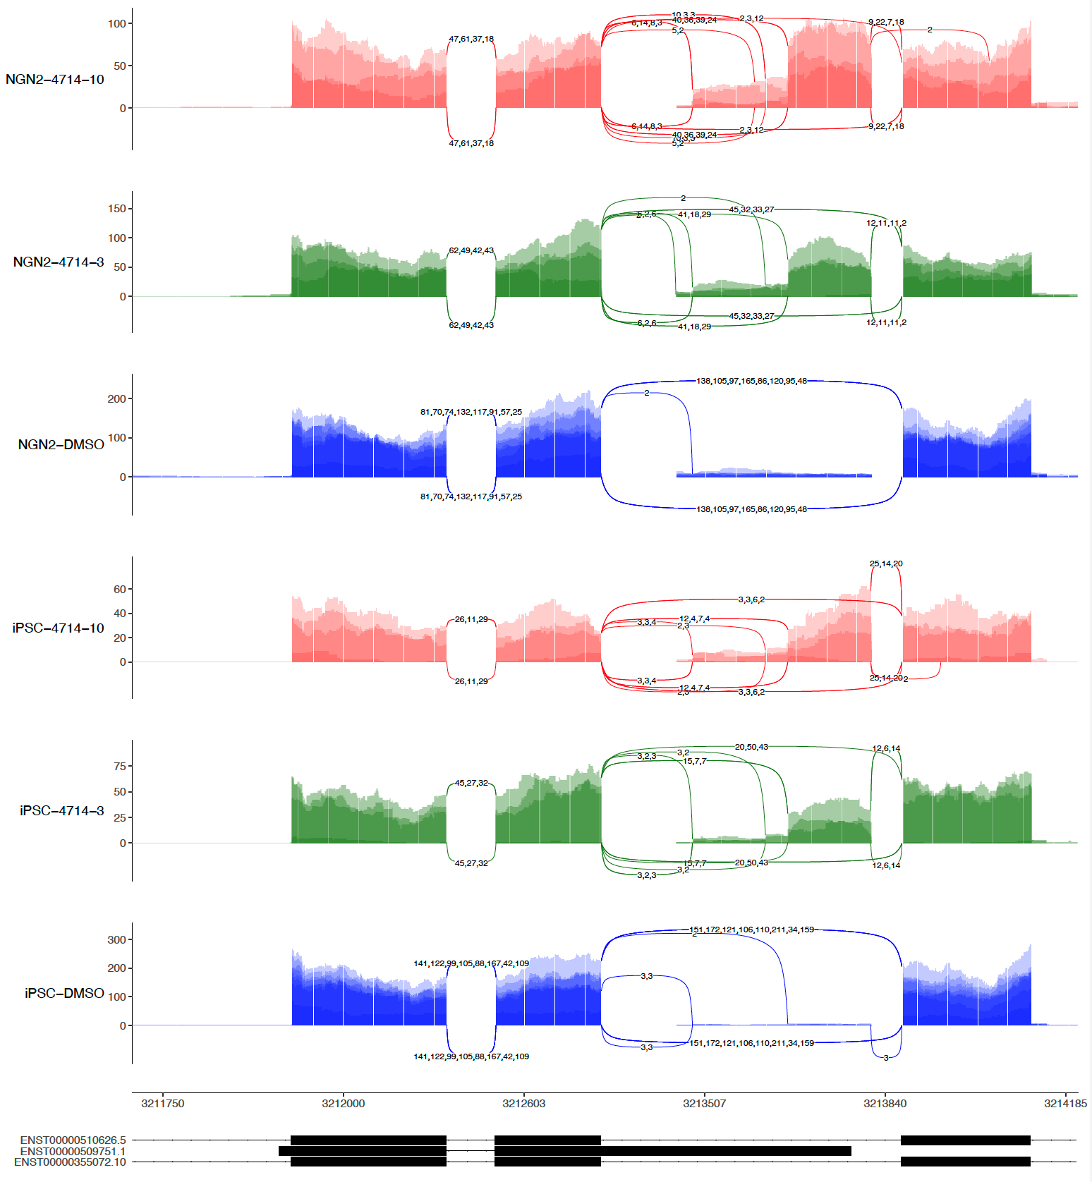
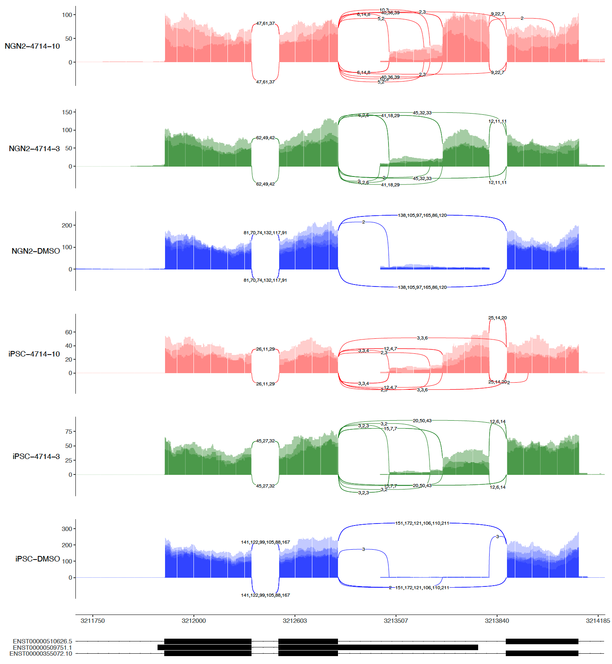
sashimi-plots: 2nd 4714
4 repeats
3 repeats (No R4)

Slide 10
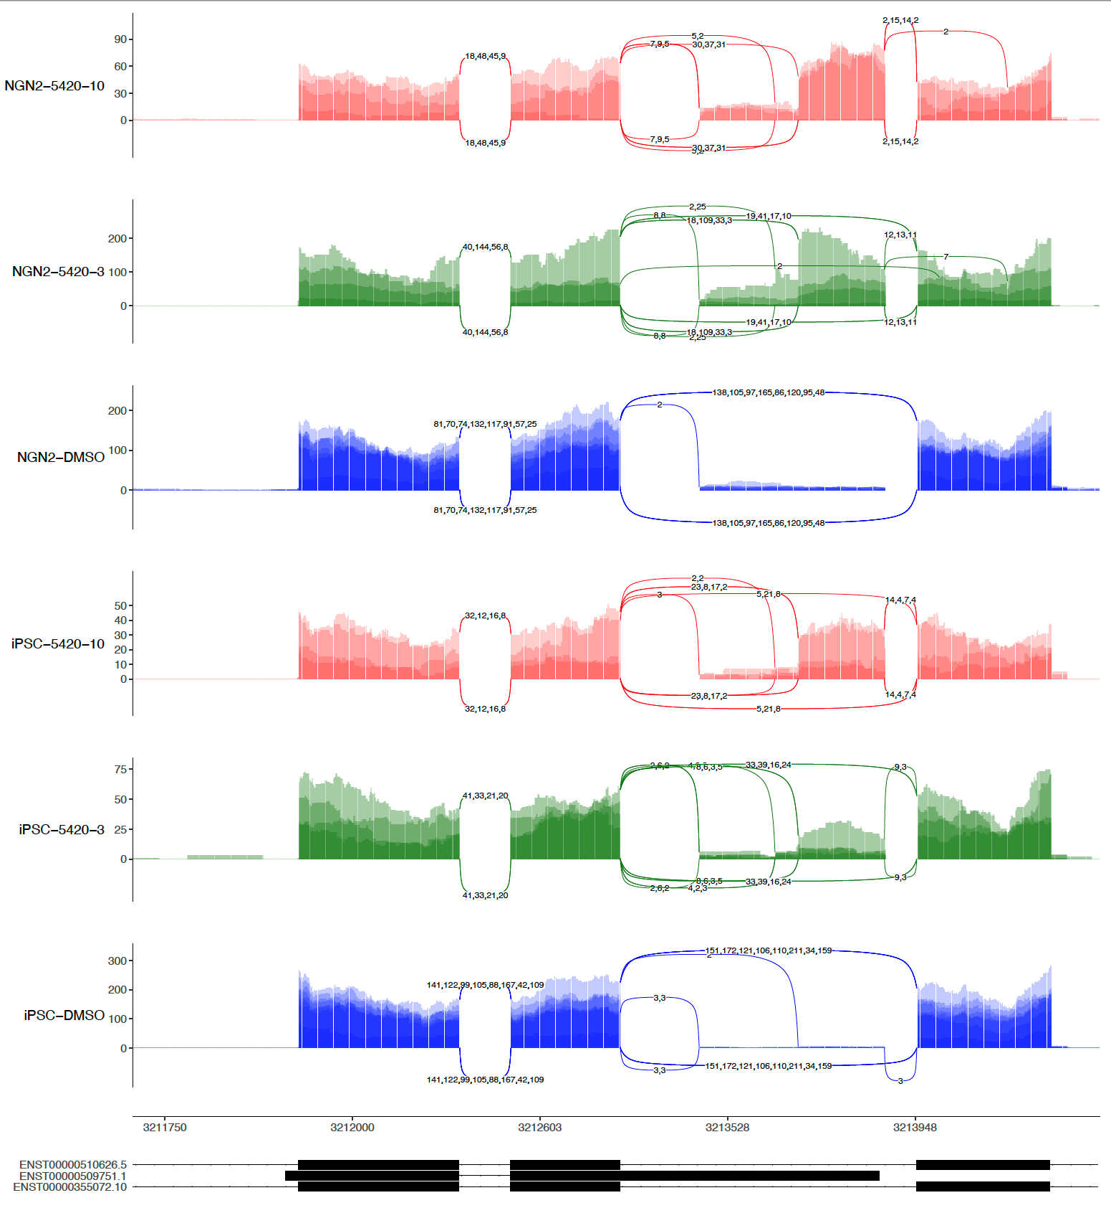
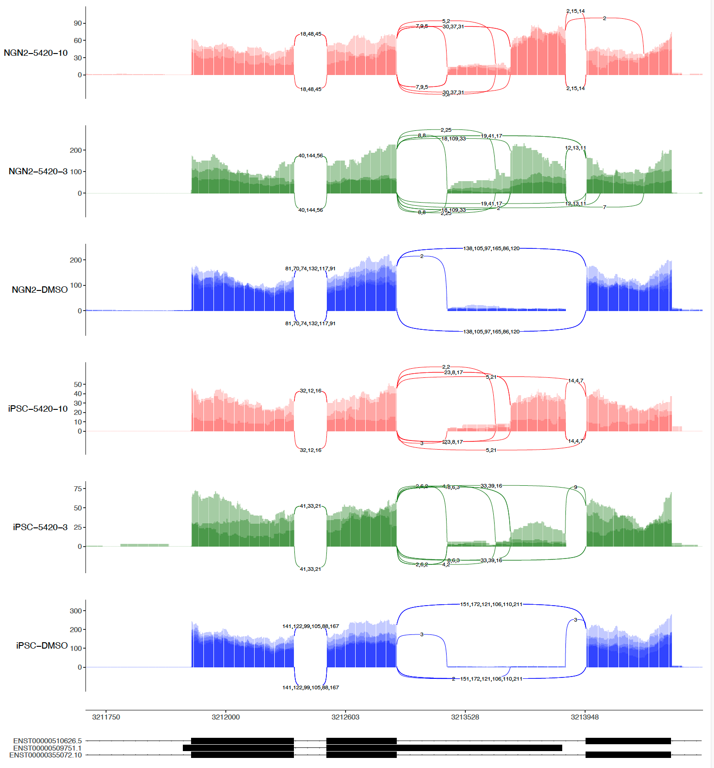
sashimi-plots: 2nd 5420
4 repeats
3 repeats (No R4)

Slide 11
sashimi-plots: 1st 6152 and 2nd 6152

Slide 12
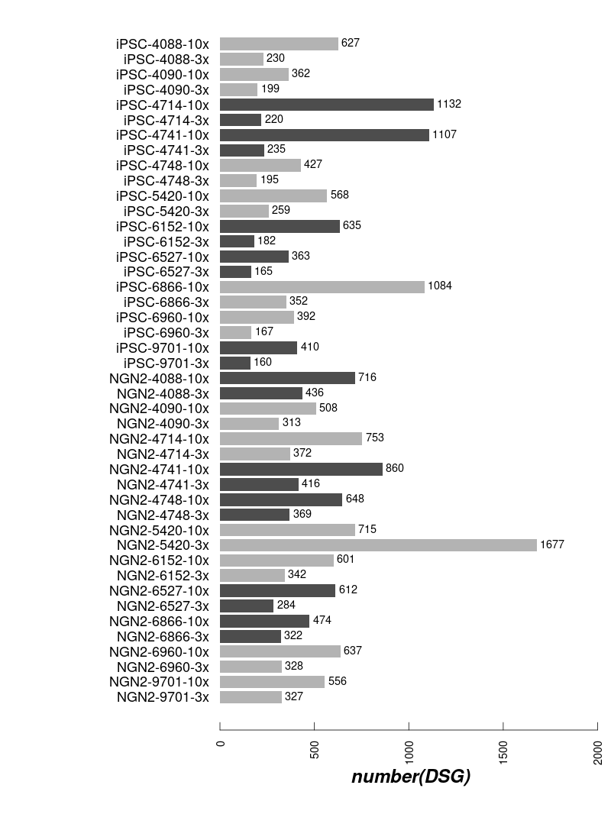
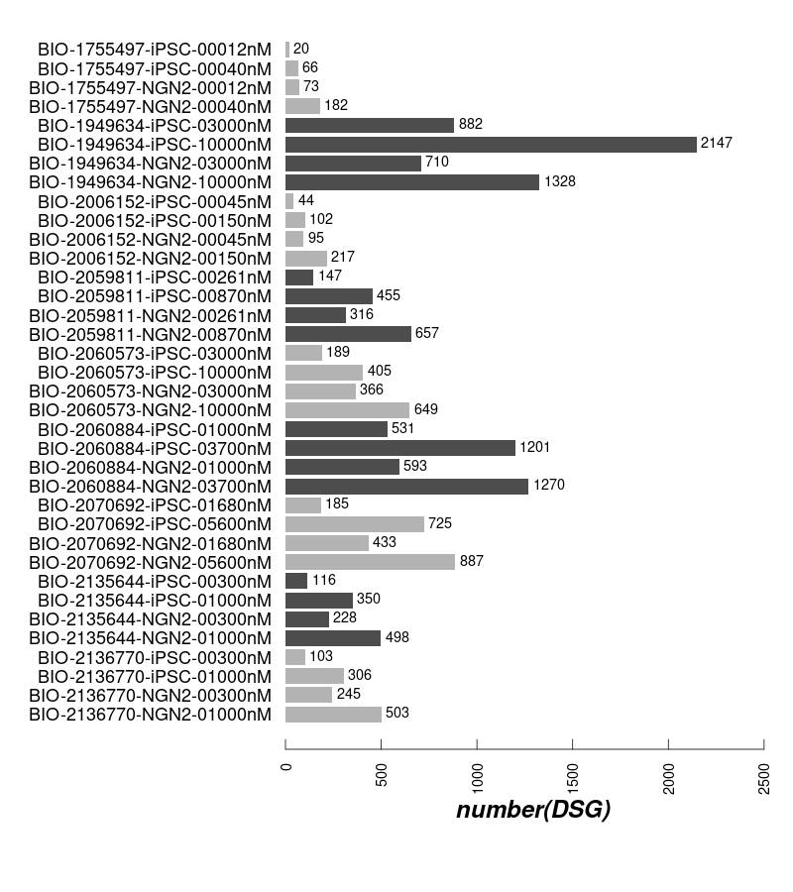
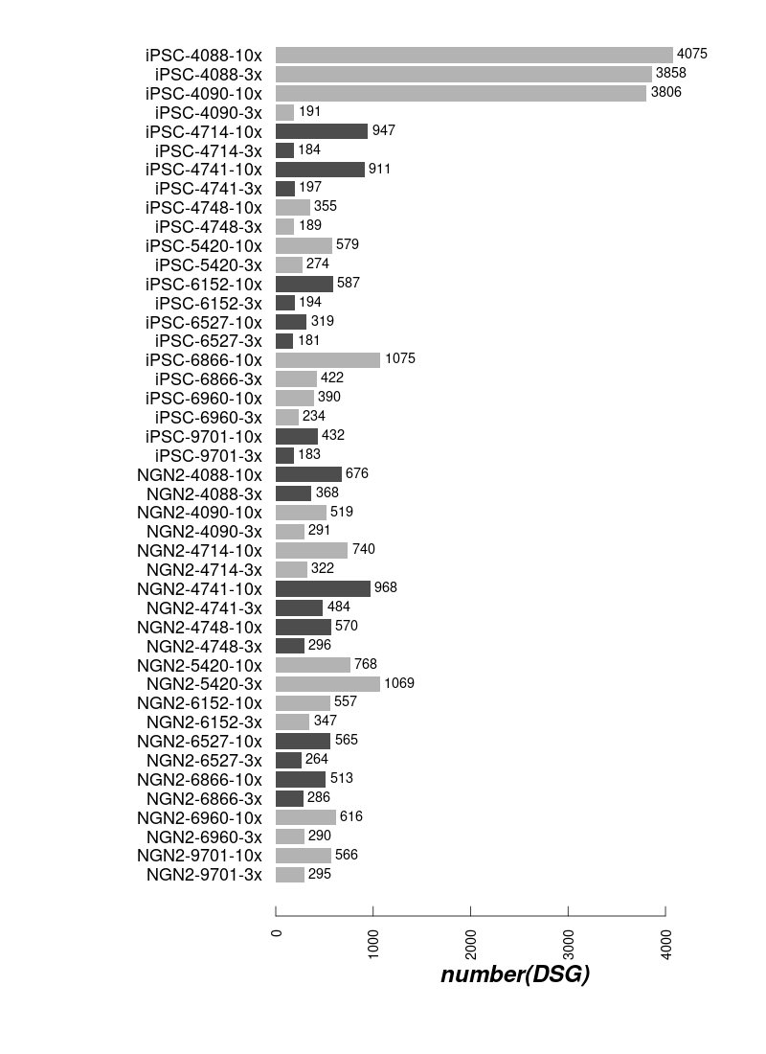
DSG: 1st batch and 2nd batch
1st batch
2nd batch with R4
2nd batch WO R4

Slide 13
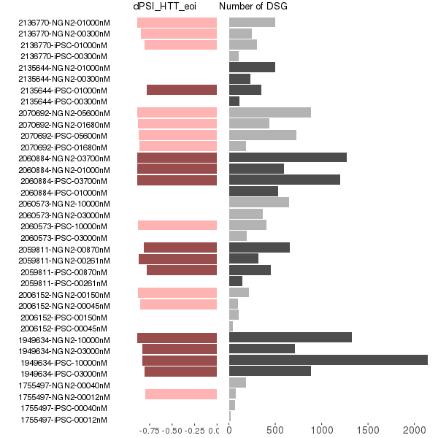
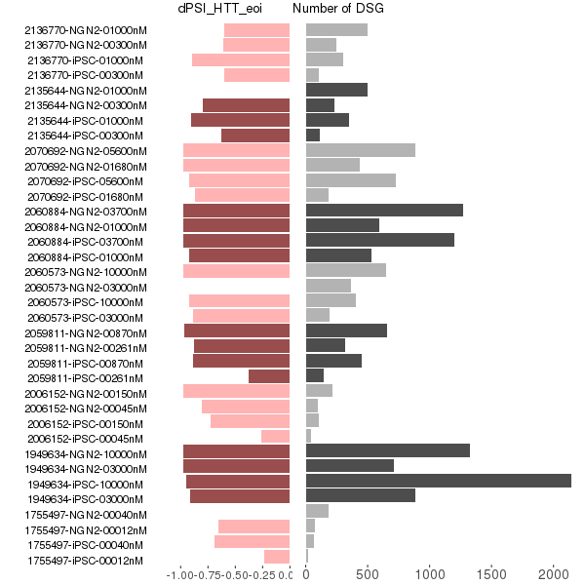
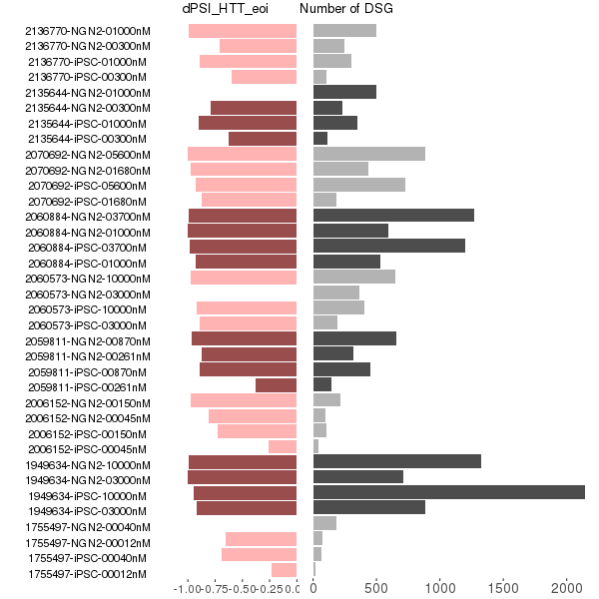
DSG and dPSI in eoi (1st batch)
Updated dPSI from leafcutter
dPSI from majiq
leafcutter majiq merged

Slide 14
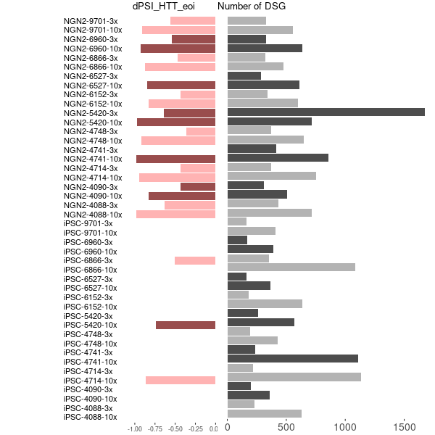
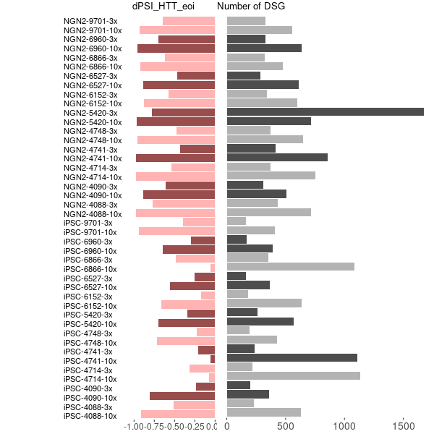
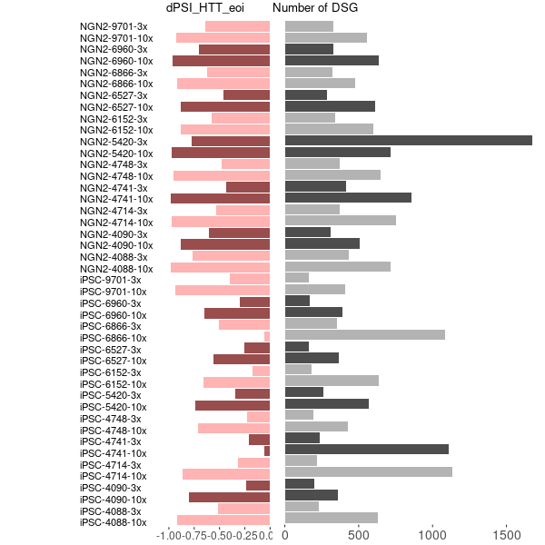
DSG and dPSI(2nd batch-No-R4)
Updated dPSI from leafcutter
dPSI from majiq
leafcutter majiq merged

Slide 15
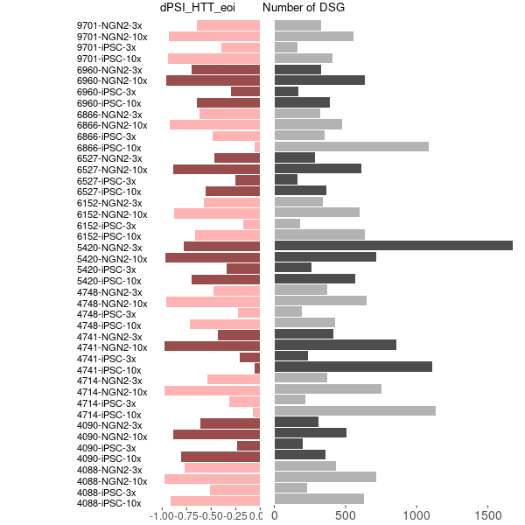
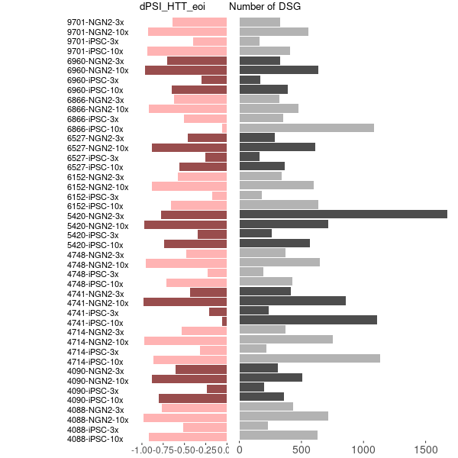
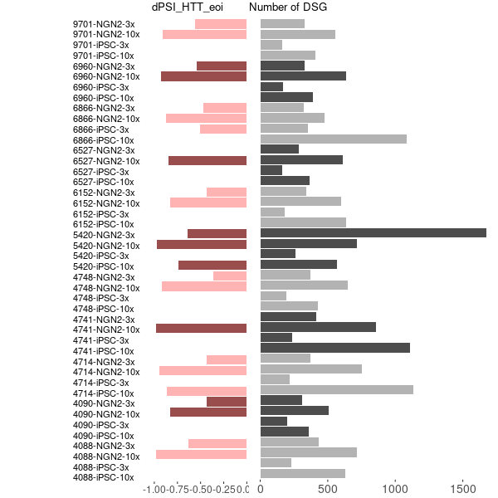
DSG and dPSI(2nd batch-No-R4)
Updated dPSI from leafcutter
dPSI from majiq
leafcutter majiq merged

Slide 16
Sample similarity from Gene Expression
Expression heatmap for iPSC
Expression heatmap for NGN2

Slide 17
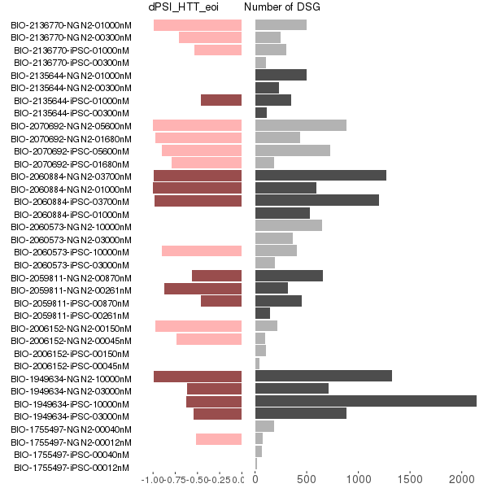
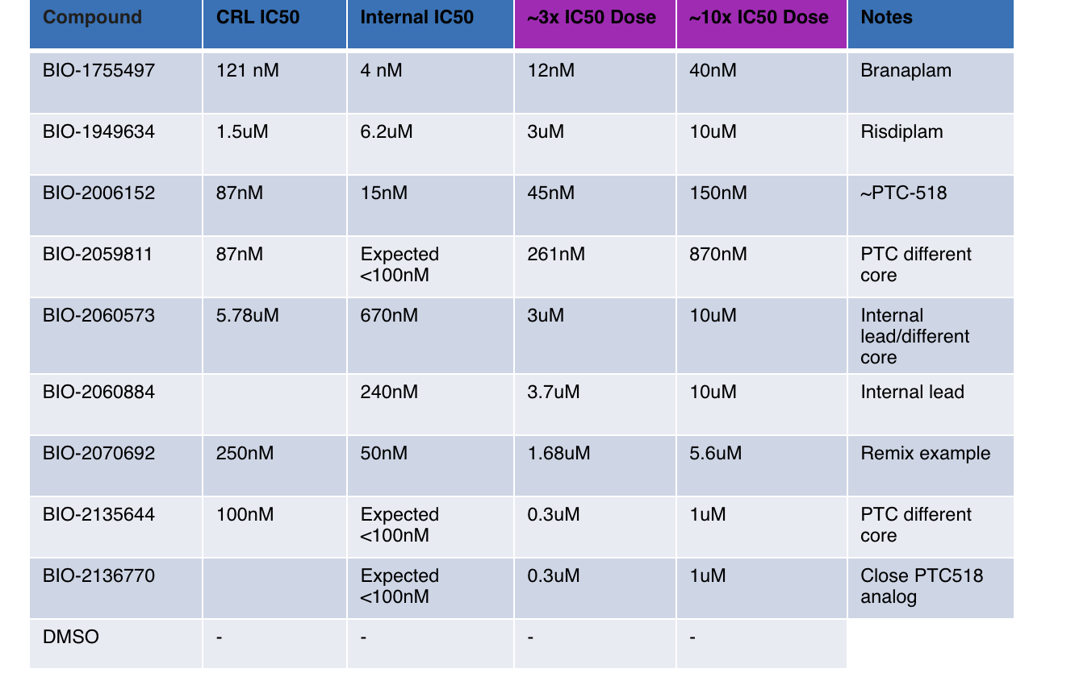
DSG and dPSI in eoi

Slide 18
Issues about the 2nd batch HTT competitors and internal compounds
Sep 26, 2022
Zhen, Dann, Catherine, Joon, Magnus, Jessica

